Slide 1
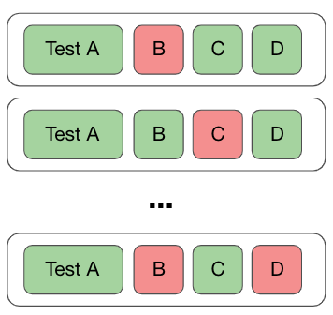
A Combined Approach to Detect Flaky Tests
Haya Samaana
Khaled Badran

Slide 2
Approach
Collect Flaky Tests
Extract Test Smells
Extract Vocabulary
Train and Test a Classifier
Analyze the Results

Slide 3
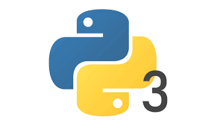
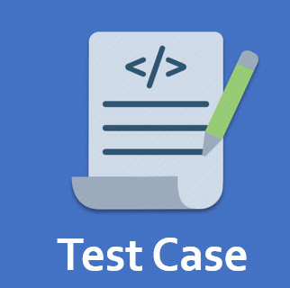
Collect Flaky Tests
Python projects
~22,000 Repositories
~800,000 Test Cases

Slide 4

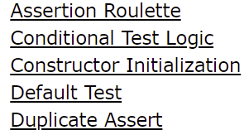
Extract Test Smells
Download the test files
PyNose for test smell extraction
20 different test smells

Slide 5

Extract Vocabulary
Extract Test Body
Remove Stop Words
Tokenize

Slide 6
Train and Test a Classifier
Prepare the data for the model
Train and Test splits

Slide 7
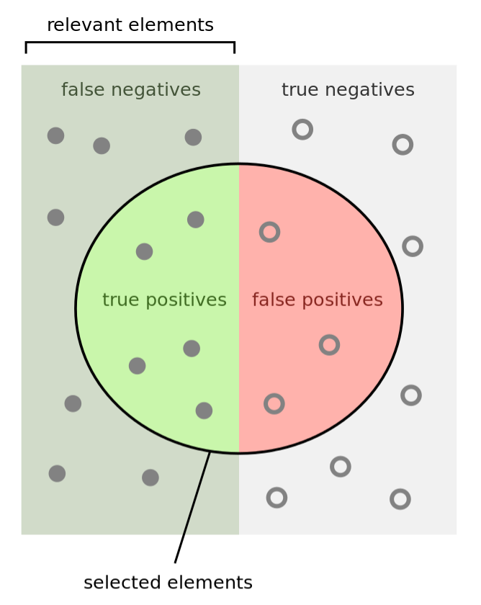
Analyze the Results
Recall, Precision and F1-Score
Information Gain

